Slide 1








On Premise
AWS Analytics using Glue & Step Functions
AWS Step Functions workflow
Curated Data
AWS Lambda
Check status of Glue ETL
Processed Data
AWS S3
JSON Files
RedShift
AWS Lambda
Initialize Job Details
AWS Lambda
Perform CSV to JSON
AWS S3
CSV Files
Choice Step
Run another Glue ETL Job?
AWS S3
Confirmed Files
AWS S3
Curated Files
AWS Glue
Transform/Processing
AWS Lambda
Invoke Glue Crawler
AWS Athena
AWS Transfer
FTP/SFTP
CSV Files
AWS Lambda
Check status of Crawler
Pass Step
Initialize Glue ETL Job
AWS Lambda
Invoke Glue ETL Job
QuckSight
Charts/Dashboard
AWS Common services
API IAM
CloudWatch
CloudTrail
Code Pipeline
AWS SQS
CloudFormation
AWS SNS
AWS S3
DynamoDB

Slide 2
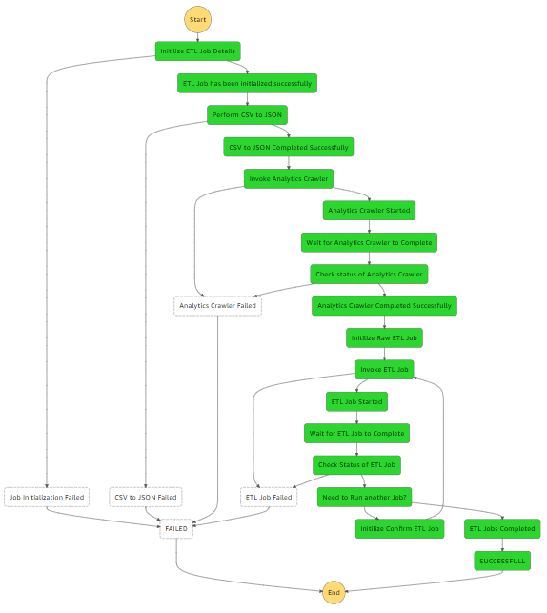
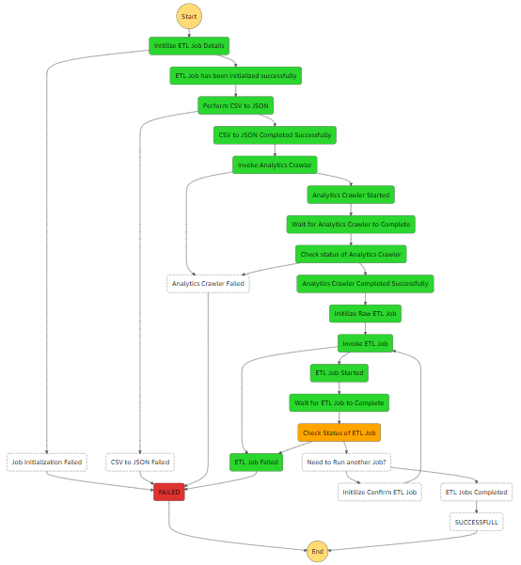
AWS Step Function Execution Flow

